Slide 1
Neural Networks
Dr. N V Subba Reddy
Manipal Institute of Technology
Manipal

Slide 2
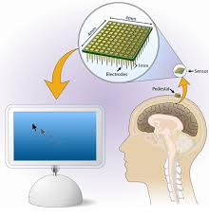
HOW COMPUTER CAN BE MADE AS A GOOD PATTERN RECOGNITION SYSTEM?
By simulating the structure and functioning of a biological neuron.
Designing an information processing device that is composed of a large number of highly interconnected computing unit working in union to solve specific Pattern Recognition problems.
Resembles the human brain in two respects:
Knowledge acquisition through learning.
Storage of knowledge in the synaptic weights.

Slide 3
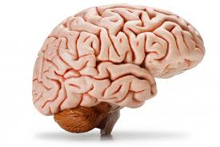
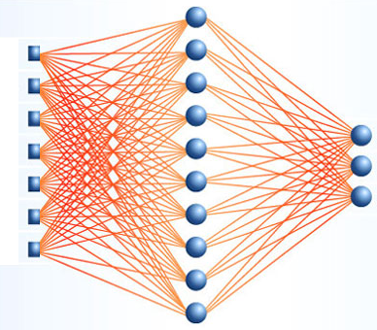
ARTIFICIAL NEURAL NETWORK
Artificial Neural Networks can be viewed as parallel and distributed processing systems which consists of a huge number of simple and massively connected processors.

Slide 4
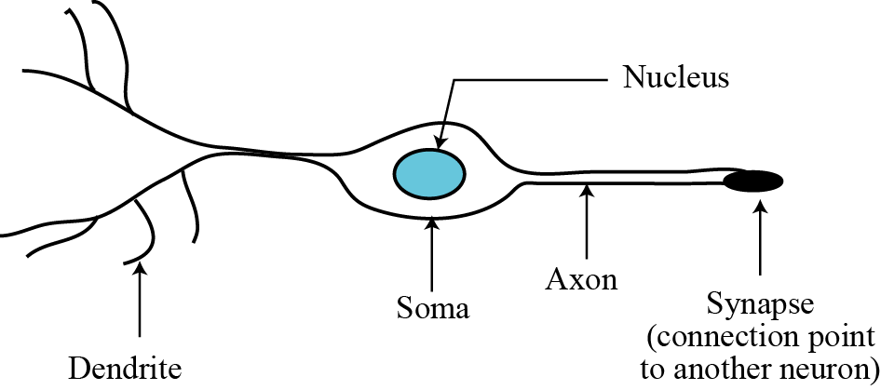
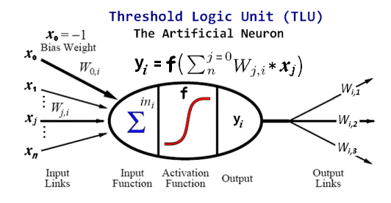
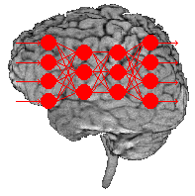
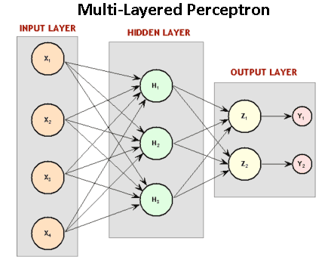
Biological neurons and Artificial Neurons
The human brain has billions of processing units, called neurons. A neuron is made of three parts: soma, axon and dendrites.
Figure A simplified diagram of a neuron and Neural Network

Slide 5
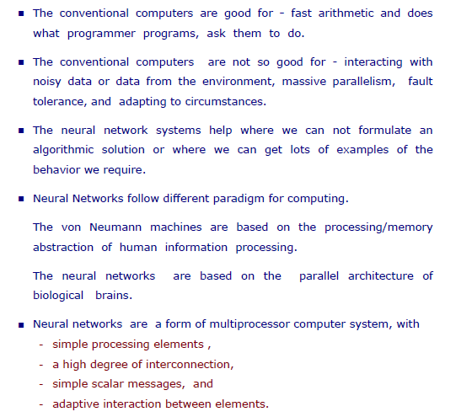
Why Neural Networks?

Slide 6
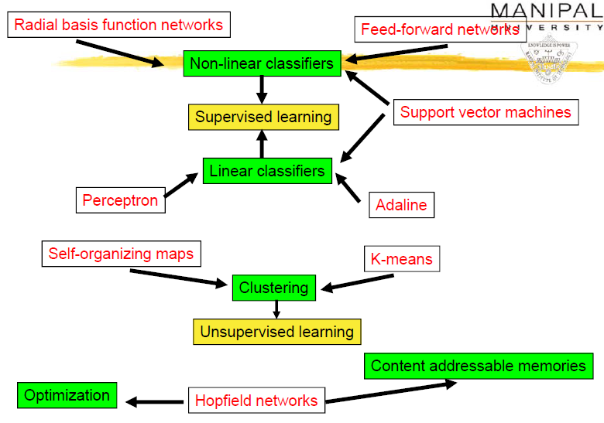
Neural Network Models

Slide 7
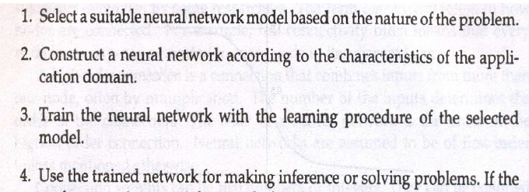
How Neural Network Works?

Slide 8
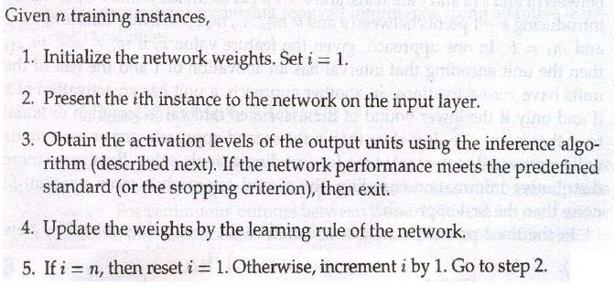
Neural Network Learning Algorithm

Slide 9
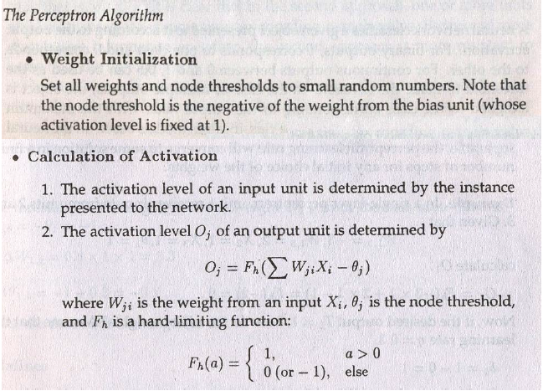
Perceptron Algorithm

Slide 10
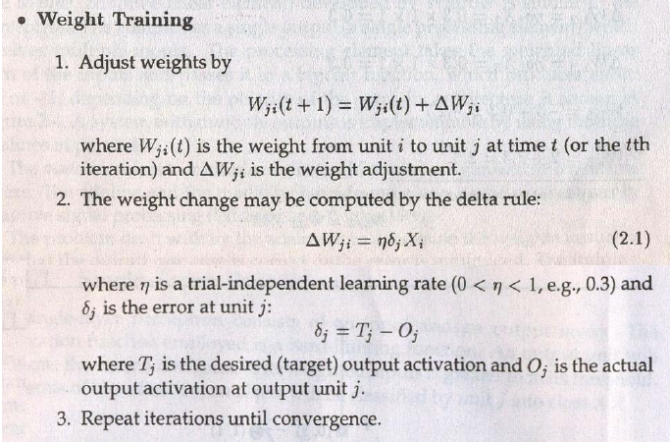
Training

Slide 11
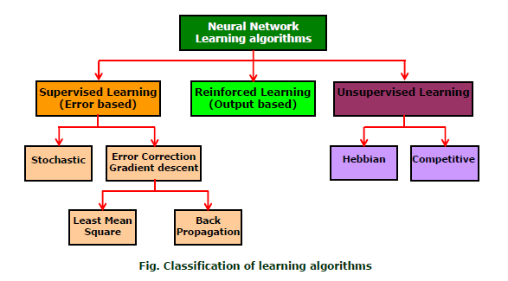
Classification of Learning Algorithms

Slide 12
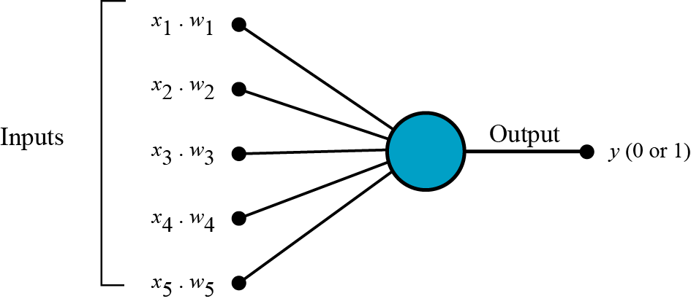
Perceptrons
A perceptron is an artificial neuron similar to a single biological neuron. It takes a set of weighted inputs, sums the inputs and compares the result with a threshold value. If the result is above the threshold value, the perceptron fires, otherwise it does not. When a perceptron fires, the output is 1: when it does not fire, the output is zero.
Figure A perceptron

Slide 13
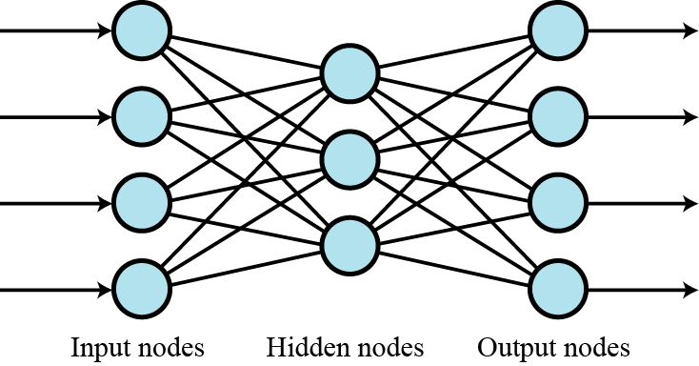
Multi-layer networks
Several layers of perceptions can be combined to create multilayer neural networks. The output from each layer becomes the input to the next layer. The first layer is called the input layer, the middle layers are called the hidden layers and the last layer is called the output layer.
Figure 18.24 A multi-layer neural network

Slide 14
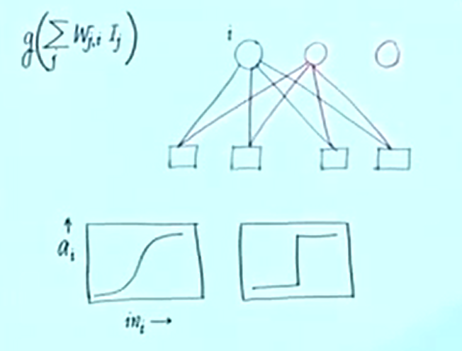
Single Layer

Slide 15
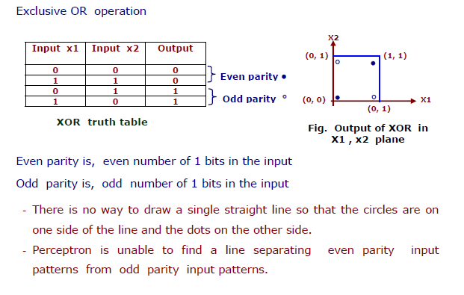
XOR Problem

Slide 16
ILLUSTRATIVE EXAMPLE
‘OR’ GATE
‘AND’ GATE
‘XOR’ GATE
X1 | X2 | Y
0 | 0 | 0
0 | 1 | 1
1 | 0 | 1
1 | 1 | 1
X1 | X2 | Y
0 | 0 | 0
0 | 1 | 0
1 | 0 | 0
1 | 1 | 1
X1 | X2 | Y
0 | 0 | 1
0 | 1 | 0
1 | 0 | 0
1 | 1 | 1
X1
X1
X1
X2
X2
X2
‘OR’ gate and ‘AND’ gate are LINEARLY SEPARABLE
‘XOR’ gate is NON-LINEAR
NOTE: Most of the data of a real world problems are non linear only

Slide 17
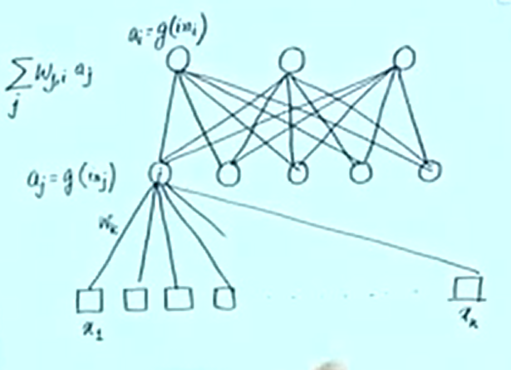
Learning Multi layer

Slide 18
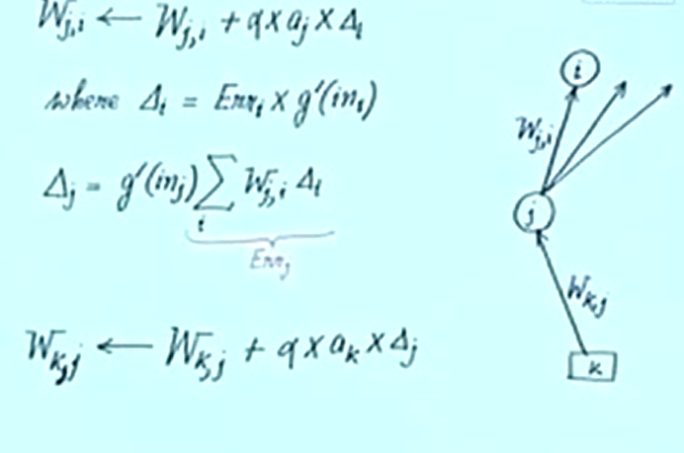
Multi layer

Slide 19
Back Propagation Algorithm
PHASE – I ➔Feed Forward Phase
Hidden Unit
Net Input
Output
Output Unit
Net Input
Output
PHASE – II ➔ Back Propagation of Error
Output Unit
Error Calculation
Change in weights and bias
Hidden unit
Net delta input
Error Calculation
Change in weights and bias
PHASE – III ➔ Weight and bias updation
Output Unit
Weight and Bias Updation
Hidden Unit
Weight and Bias Updation
19

Slide 20
DESIGN PARAMETERS
Number of Training/Testing Data
Nature of Training
Selection of Network Structure
Weights and Bias
Learning Rate and Momentum
Termination Criteria
Goal and Epoch
Overfitting/Overtraining and validation
Generalization Vs Memorization

Slide 21
STEPS OF DEVELOPING AN ANN MODEL
Loading the data set
Separating the data set into Training and Testing Data
Defining the network structure
Setting initial values for weights and bias
Training the network
Testing the network
Displaying the result

Slide 22
Case Study - 01

Slide 23
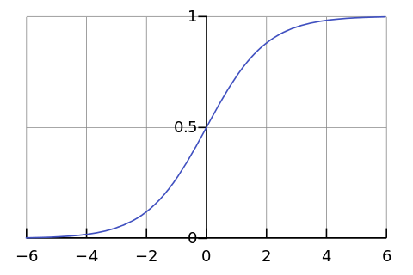
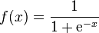
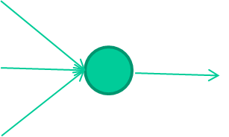
-0.06
W1
W2
f(x)
-2.5
W3
1.4

Slide 24
-0.06
2.7
-8.6
f(x)
-2.5
0.002
x = -0.06×2.7 + 2.5×8.6 + 1.4×0.002 = 21.34
1.4

Slide 25
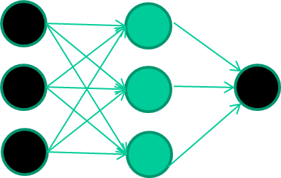
A dataset
Fields class
1.4 2.7 1.9 0
3.8 3.4 3.2 0
6.4 2.8 1.7 1
4.1 0.1 0.2 0
etc …

Slide 26
Training the neural network
Fields class
1.4 2.7 1.9 0
3.8 3.4 3.2 0
6.4 2.8 1.7 1
4.1 0.1 0.2 0
etc …

Slide 27
Training data
Fields class
1.4 2.7 1.9 0
3.8 3.4 3.2 0
6.4 2.8 1.7 1
4.1 0.1 0.2 0
etc …
Initialise with random weights

Slide 28
Training data
Fields class
1.4 2.7 1.9 0
3.8 3.4 3.2 0
6.4 2.8 1.7 1
4.1 0.1 0.2 0
etc …
Present a training pattern
1.4
2.7
1.9

Slide 29
Training data
Fields class
1.4 2.7 1.9 0
3.8 3.4 3.2 0
6.4 2.8 1.7 1
4.1 0.1 0.2 0
etc …
Feed it through to get output
1.4
2.7 0.8
1.9

Slide 30
Training data
Fields class
1.4 2.7 1.9 0
3.8 3.4 3.2 0
6.4 2.8 1.7 1
4.1 0.1 0.2 0
etc …
Compare with target output
1.4
2.7 0.8
0
1.9 error 0.8

Slide 31


Training data
Fields class
1.4 2.7 1.9 0
3.8 3.4 3.2 0
6.4 2.8 1.7 1
4.1 0.1 0.2 0
etc …
Adjust weights based on error
1.4
2.7 0.8
0
1.9 error 0.8

Slide 32
Training data
Fields class
1.4 2.7 1.9 0
3.8 3.4 3.2 0
6.4 2.8 1.7 1
4.1 0.1 0.2 0
etc …
Present a training pattern
6.4
2.8
1.7

Slide 33
Training data
Fields class
1.4 2.7 1.9 0
3.8 3.4 3.2 0
6.4 2.8 1.7 1
4.1 0.1 0.2 0
etc …
Feed it through to get output
6.4
2.8 0.9
1.7

Slide 34
Training data
Fields class
1.4 2.7 1.9 0
3.8 3.4 3.2 0
6.4 2.8 1.7 1
4.1 0.1 0.2 0
etc …
Compare with target output
6.4
2.8 0.9
1
1.7 error -0.1

Slide 35
Training data
Fields class
1.4 2.7 1.9 0
3.8 3.4 3.2 0
6.4 2.8 1.7 1
4.1 0.1 0.2 0
etc …
Adjust weights based on error
6.4
2.8 0.9
1
1.7 error -0.1

Slide 36
Training data
Fields class
1.4 2.7 1.9 0
3.8 3.4 3.2 0
6.4 2.8 1.7 1
4.1 0.1 0.2 0
etc …
And so on ….
6.4
2.8 0.9
1
1.7 error -0.1
Repeat this thousands, maybe millions of times – each time
taking a random training instance, and making slight
weight adjustments
Algorithms for weight adjustment are designed to make
changes that will reduce the error

Slide 37
The decision boundary perspective…
Initial random weights

Slide 38
The decision boundary perspective…
Present a training instance / adjust the weights

Slide 39
The decision boundary perspective…
Present a training instance / adjust the weights

Slide 40
The decision boundary perspective…
Present a training instance / adjust the weights

Slide 41
The decision boundary perspective…
Present a training instance / adjust the weights

Slide 42
The decision boundary perspective…
Eventually ….

Slide 43
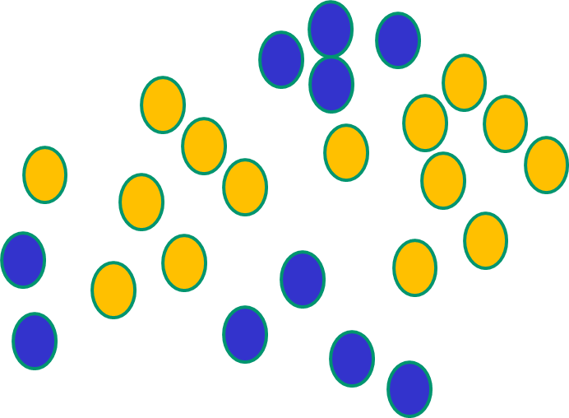
Some other ‘by the way’ points
If f(x) is linear, the NN can only draw straight decision boundaries (even if there are many layers of units)

Slide 44
Some other ‘by the way’ points
NNs use nonlinear f(x) so they
can draw complex boundaries,
but keep the data unchanged

Slide 45
Some other ‘by the way’ points
NNs use nonlinear f(x) so they SVMs only draw straight lines,
can draw complex boundaries, but they transform the data first
but keep the data unchanged in a way that makes that OK

Slide 46
Case Study - 02

Slide 47
Case Study
Suppose we have a net consisting of a single neuron.
The summation function is the standard version.
The transformation function is a step function.
There are two inputs and one output,
We wish to teach this net the logical INCLUSIVE OR function, i.e.
if the values of both the inputs is 0, the output should be 0;
if the value of either or both the inputs is 1, the output should be 1.

Slide 48
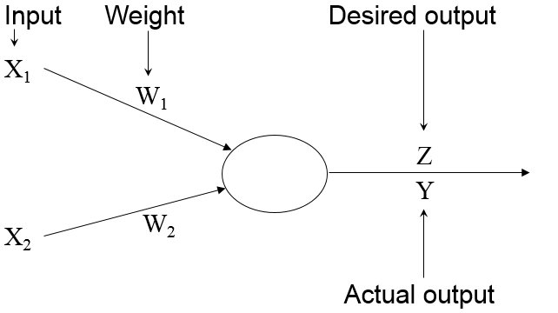
Case Study
We will represent the values of the two inputs as X₁ and X₂, the desired output as Z, the weights on the two inputs as W₁ and W₂, the actual output as Y.

Slide 49
Case Study
The learning process involves repeated applying the four possible patterns of input:
X₁ X₂ Z
0 0 0
0 1 1
1 0 1
1 1 1

Slide 50
Case Study
The two weights W₁ and W₂ are initially set to random values. Each time a set of inputs is applied, a value Δ is calculated as
Δ = Z - Y
(the difference between what you got and what you wanted)
and the weights are adjusted.
The new weight, V for a particular input i is given by
V_{i} = W_{i} + α * Δ * X_{i}
where α is a parameter which determines how much the weights are allowed to fluctuate in a particular cycle, and hence how quickly learning takes place.
An actual learning sequence might be as follows:

Slide 51
Iteration-01
α = 0.2 threshold = 0.5
Iter-
ation X₁ X₂ Z W₁ W₂ Y Δ V₁ V₂
_______________________________________
1 0 0 0 0.1 0.3 0 0.0 0.1 0.3
0 1 1 0.1 0.3 0 1.0 0.1 0.5
1 0 1 0.1 0.5 0 1.0 0.3 0.5
1 1 1 0.3 0.5 1 0.0 0.3 0.5

Slide 52
Iteration-02
α = 0.2 threshold = 0.5
Iter-
ation X₁ X₂ Z W₁ W₂ Y Δ V₁ V₂
_______________________________________
2 0 0 0 0.3 0.5 0 0.0 0.3 0.5
0 1 1 0.3 0.5 0 1.0 0.3 0.7
1 0 1 0.3 0.7 0 1.0 0.5 0.7
1 1 1 0.5 0.7 1 0.0 0.5 0.7

Slide 53
Iteration-03
α = 0.2 threshold = 0.5
Iter-
ation X₁ X₂ Z W₁ W₂ Y Δ V₁ V₂
_______________________________________
3 0 0 0 0.5 0.7 0 0.0 0.5 0.7
0 1 1 0.5 0.7 1 0.0 0.5 0.7
1 0 1 0.5 0.7 0 1.0 0.7 0.7
1 1 1 0.7 0.7 1 0.0 0.7 0.7

Slide 54
Iteration-04
α = 0.2 threshold = 0.5
Iter-
ation X₁ X₂ Z W₁ W₂ Y Δ V₁ V₂
_______________________________________
4 0 0 0 0.7 0.7 0 0.0 0.7 0.7
0 1 1 0.7 0.7 1 0.0 0.7 0.7
1 0 1 0.7 0.7 1 0.0 0.7 0.7
1 1 1 0.7 0.7 1 0.0 0.7 0.7
- no errors detected for an entire iteration: learning halts.

Slide 55
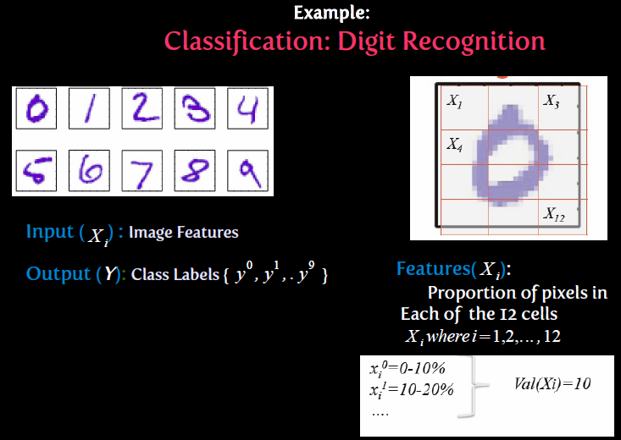
Classification : Digit Recognition System

Slide 56
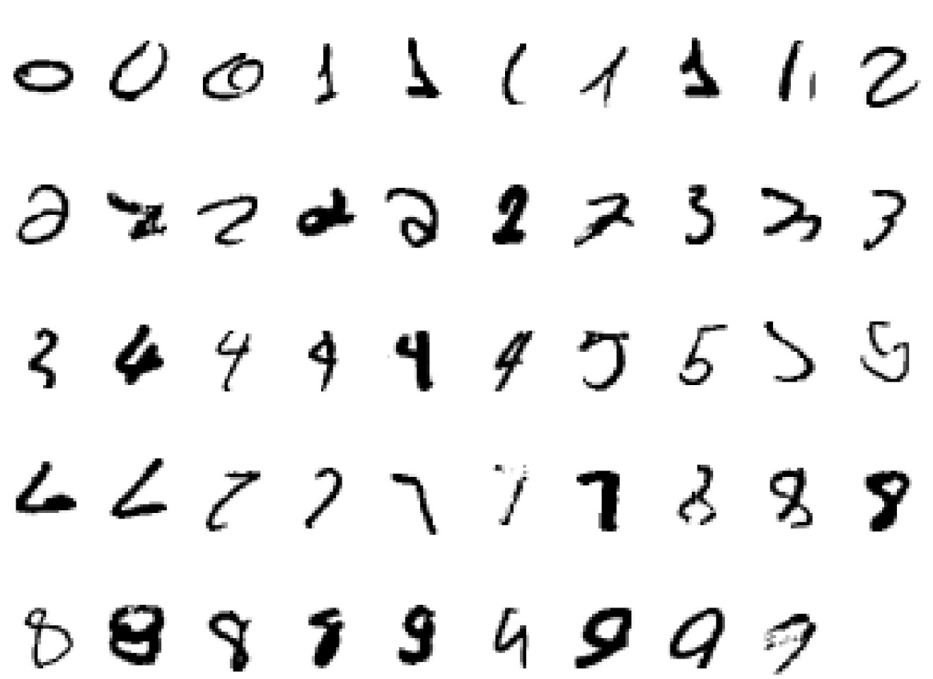
A classic example of a task that requires machine learning: It is very hard to say what makes a 2

Slide 57
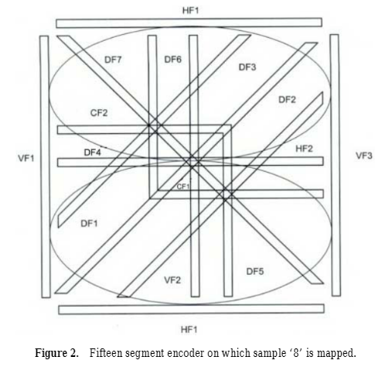
Encoder

Slide 58
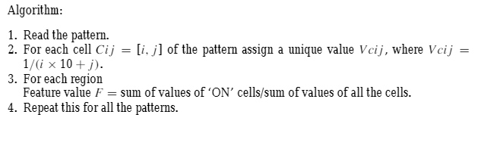
Algorithm

Slide 59
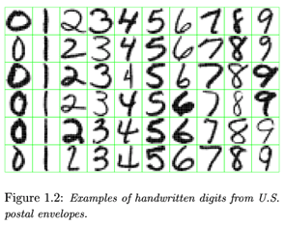
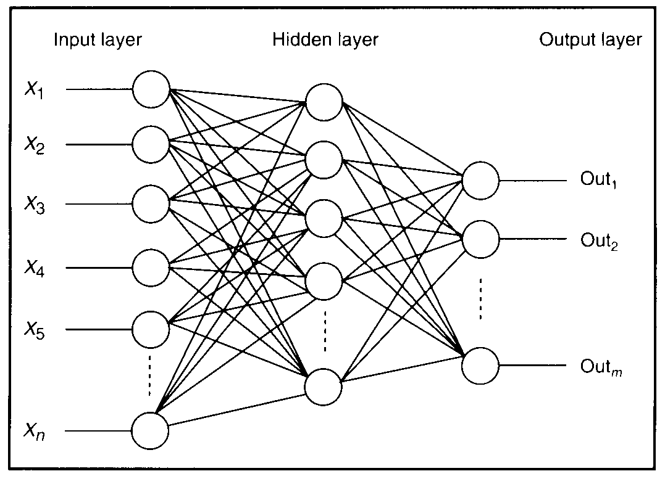
Feature detectors

Slide 60
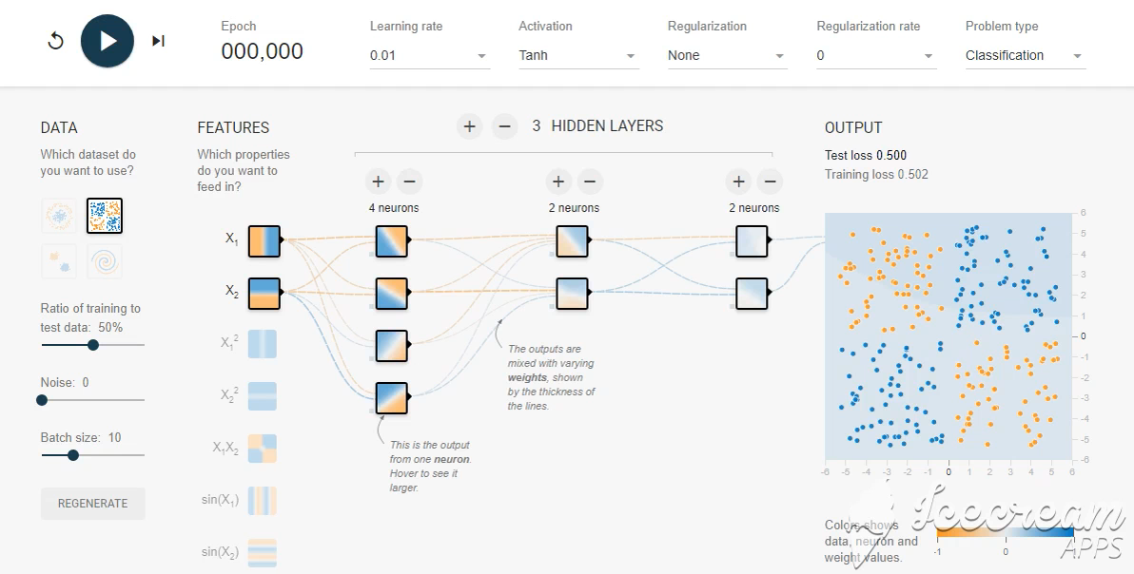
Visualization

Slide 61
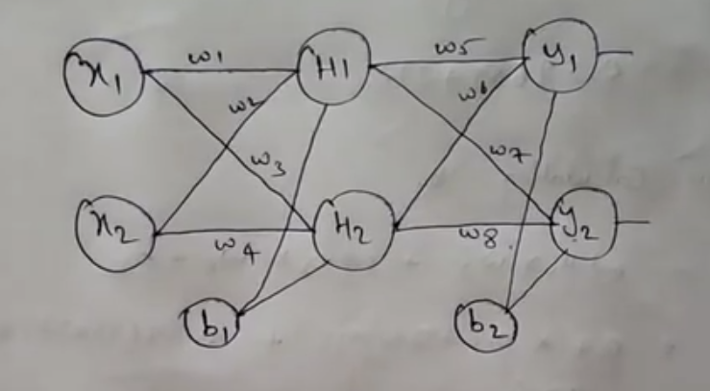
Neural Networks

Slide 62
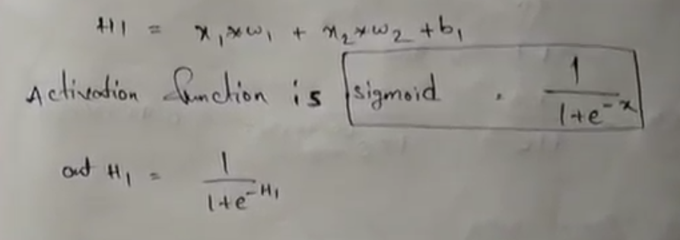
Activation function

Slide 63
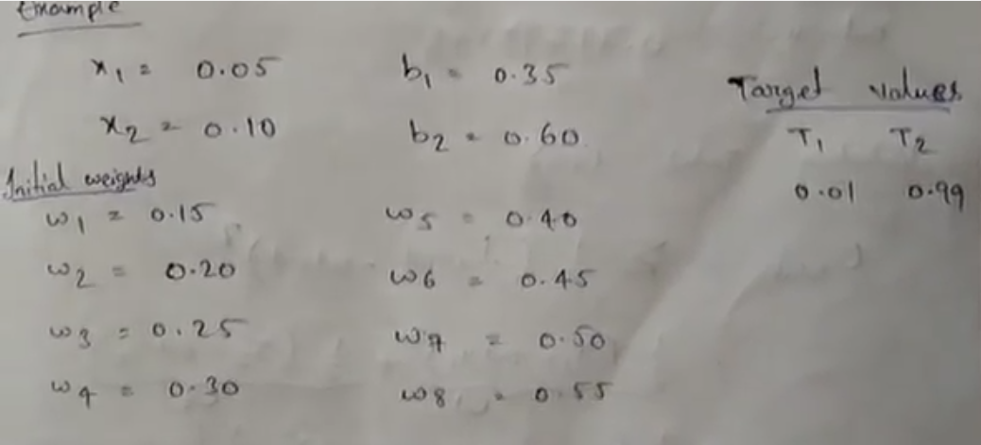
Example

Slide 64
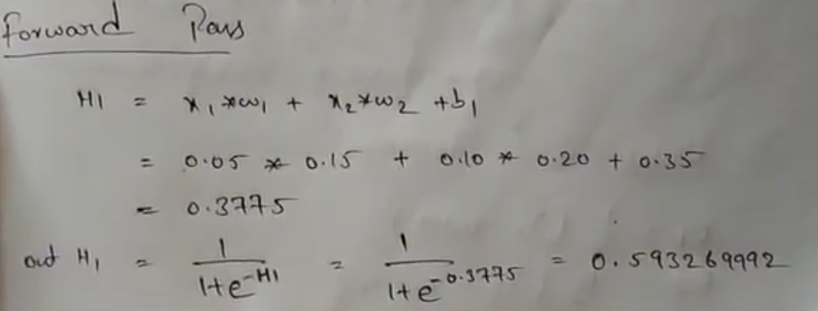
Foward Pass

Slide 65
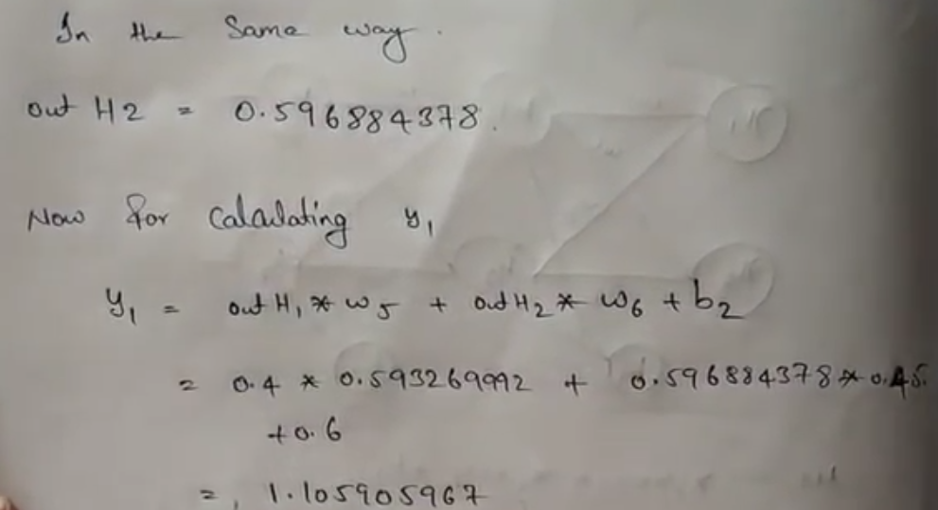
Forward Pass

Slide 66
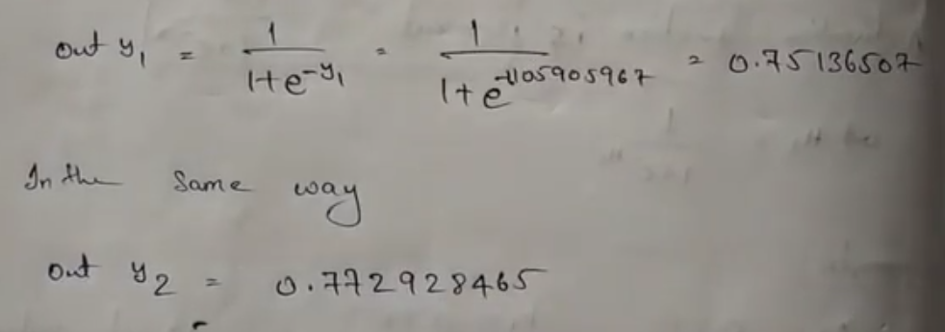
Forward Pass

Slide 67
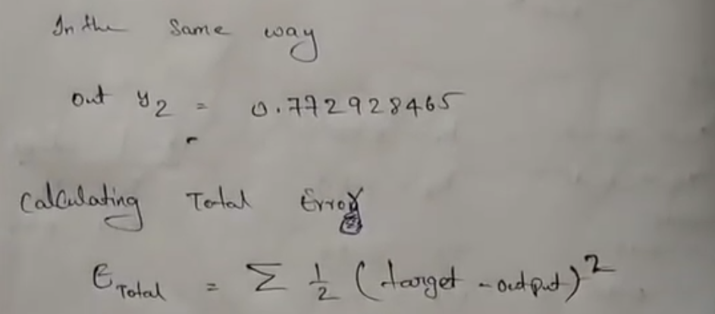
Forward pass

Slide 68
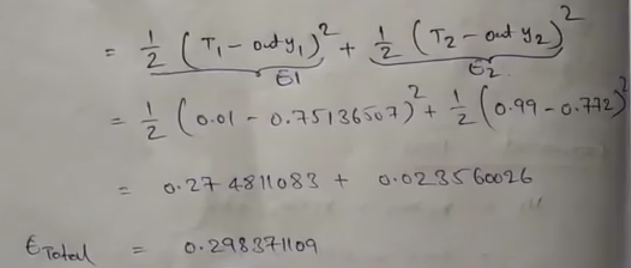
Forward

Slide 69
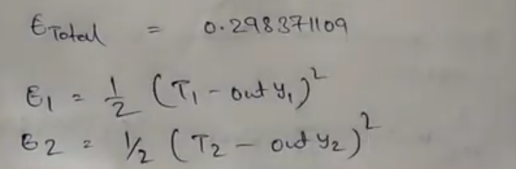
Forward

Slide 70
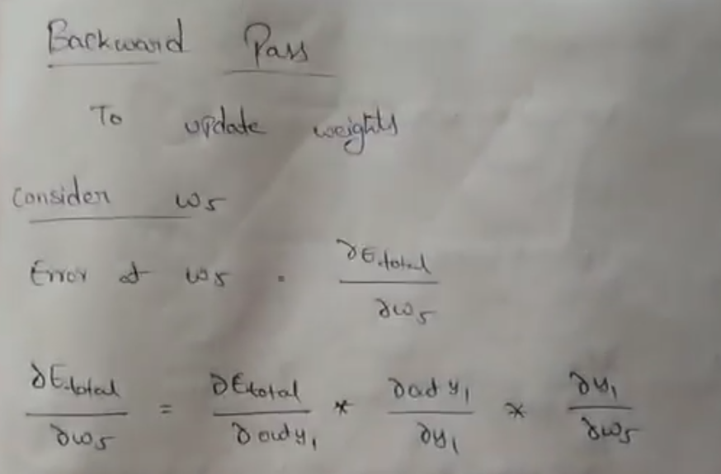
Backward Pass

Slide 71
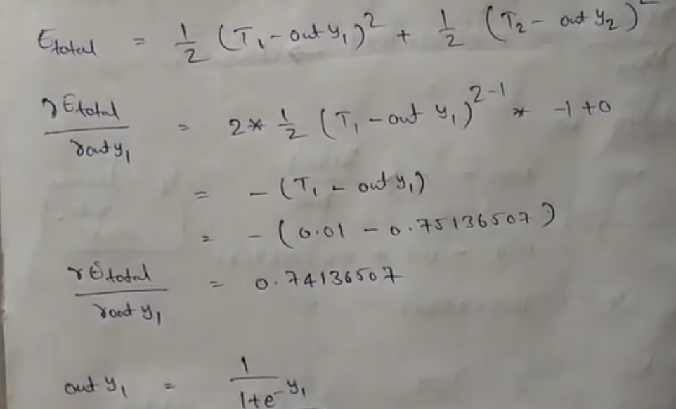
Backward Pass

Slide 72
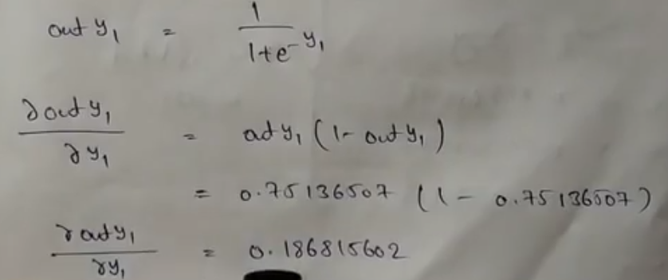
Backward Pass

Slide 73
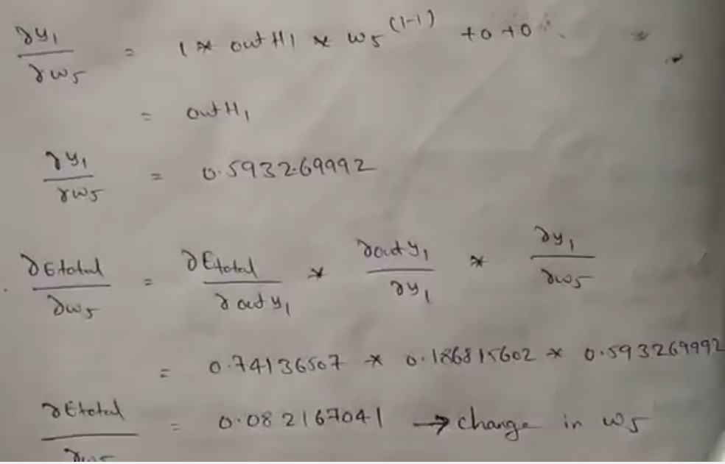
Backward Pass

Slide 74
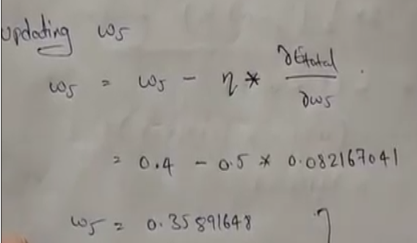
Backward Pass

Slide 75
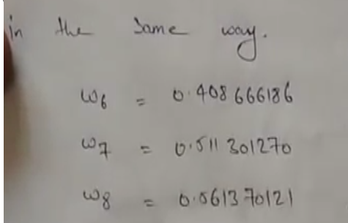
Backward Pass

Slide 76
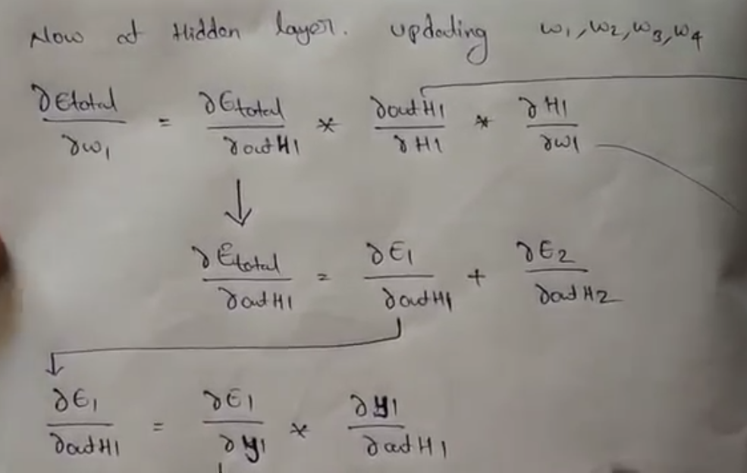
Backward Pass

Slide 77
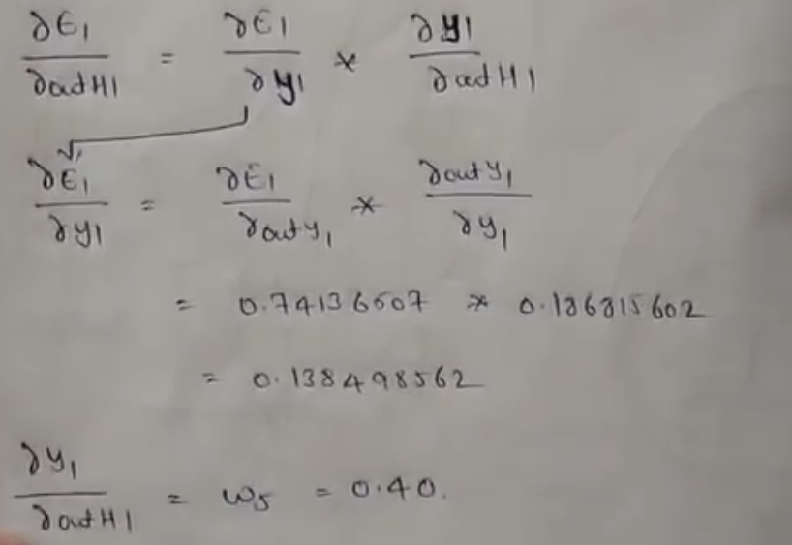
Backward Pass

Slide 78

Backward Pass

Slide 79

Backward Pass

Slide 80

Backward Pass

Slide 81

Backward Pass

Slide 82
Intelligent System

Slide 83



Introduction
Intelligent Systems use machine learning algorithms to provide an output for every input, irrespective of the accuracy.
Emotions such as ‘uncertainty’ can be introduced in intelligent systems to make them similar to humans and more reliable.
Using uncertainty, the system can be trained to give the output ‘I don’t know’ in cases that lack clarity
Two high accuracy intelligent systems can be made to coordinate using a Hybrid Classifier that employs a multi model strategy

Slide 84
Introduction
The quality of uncertainty can be introduced in Intelligent Systems using the multi-model strategy shown below
SAIS
Classifier 1
Classifier 2
Classifier 3
Test
file
Preprocess
file
Classify
Classify
Classify
No
P above
threshold?
No output
Yes
No
Same
Output?
Provide output
Yes

Slide 85



Introduction
The dataset used to demonstrate the effectiveness of the Semi-Automated Intelligent System is a collection of 32,400 news articles taken from the website “Inshorts”, where each article is written in 60 words or less
The articles were collected from 3 categories – Sports, Technology and Entertainment with 10,800 articles per category
The 10,800 articles per category were split into 8100 articles for training and 2700 for testing.

Slide 86
Data Preprocessing
Several techniques were applied to pre-process the News articles dataset. After careful evaluation, the following techniques were chosen for optimum results.
Tokenization:
“Hello hello! Are you considering Engineering 101?” -> “Hello”, “hello”, “Are”, “you”, “considering”, “Engineering”, “101”
Normalization:
“Hello”, “hello”, “Are”, “you”, “considering”, “Engineering”, “101” -> “hello”, “hello”, “are”, “you”, “considering”, “engineering”, “101”
Lemmatization:
“considering”, “engineering” -> “consider”, “engineer”
Removal of duplicates:
“hello”, “hello”, “are”, “you”, “consider”, “engineer”, “101” -> “hello”, “are”, “you”, “consider”, “engineer”, “101”
Removal of stop words:
“hello”, “are”, “you”, “consider”, “engineer”, “101” -> “hello”, “consider”, “engineer”

Slide 87
Classification Process
The first classifier used to learn the News Articles dataset was a Naïve Bayesian Classifier (NBC)
woman | team | gold | class_label
0 | 2 | 2 | Sports
0 | 0 | 1 | Tech
1 | 0 | 0 | Entertainment
To calculate prior probability of a word using NBC:
P(w_{k}/v_{j}) = n_{k} + 1
(n + |Vocabulary|)
To calculate posterior probability of a document using NBC:
m
P(v_{j}/t_{i}) = P(v_{j}/w₁, w₂, … w_{m}) = P(v_{j}) * ∏ P(w_{k}/v_{j})
k=1

Slide 88
Classification Process
The second classifier used on the News Articles dataset was a Random Forest Classifier (RFC)
Number of estimators (decision trees) – 500
Dataset splitting – Bagging (Bootstrap Aggregating)
Splitting criteria – Gini Index
Decision Tree
Decision Tree
Decision Tree
Majority voting
Output

Slide 89
Classification Process
The third classifier used on the News Articles dataset was a Multi Layer Perceptron (MLP)
Number of hidden layers for News Articles Dataset - 2
Number of neurons per hidden layer for News Articles Dataset - 100
Learning rate – 1x10⁻⁷
Activation Function – Sigmoid function
Output Layer
Input Layer
Hidden Layer

Slide 90
Results
Accuracy
Naïve Bayesian Classifier – 96.36
Multi Layer Perceptron – 95.54
Random Forest Classifier – 95.23
Confusion Matrix
Actual\Predicted | Sports | Technology | Entertainment
Sports | 2580 | 101 | 19
Technology | 18 | 2659 | 23
Entertainment | 61 | 73 | 2566
Actual\Predicted | Sports | Technology | Entertainment
Sports | 2585 | 100 | 15
Technology | 36 | 2618 | 46
Entertainment | 61 | 103 | 2536
Actual\Predicted | Sports | Technology | Entertainment
Sports | 2581 | 102 | 17
Technology | 40 | 2628 | 32
Entertainment | 57 | 138 | 2505

Slide 91



Results
The probability threshold P was calculated for each model as the average of probabilities of misclassification
Average Probability of Misclassification
Naïve Bayesian Classifier – 0.93
Multi Layer Perceptron – 0.98
Random Forest Classifier – 0.89
Graph showing Test Article Probability vs Probability Threshold

Slide 92
Results
The results obtained by the Semi-Automated Intelligent System are documented below as a confusion matrix along with other details.
Actual\Predicted | Sports | Technology | Entertainment
Sports | 1334 | 0 | 0
Technology | 0 | 1493 | 1
Entertainment | 1 | 5 | 1318
Accuracy for entire testing data – 51.17% Number of predictions made – 4145 Accuracy for only predicted articles – 99.83%

Slide 93
Results
The results obtained for NBC, MLP, RFC and SAIS are compared in the table below
 | NBC | MLP | RFC | SAIS
Predictions provided | 8100 | 8100 | 8100 | 4152
True Predictions | 7805 | 7739 | 7714 | 4145
False Predictions | 295 | 361 | 386 | 7
Accuracy (%) | 96.36 | 95.54 | 95.23 | 99.83

Slide 94

Challenges
One challenge that was faced during the implementation of the hybrid classifier was because of the varying accuracies provided by the Random Forest Classifier (RFC).
The varying results of RFC can be attributed to Bootstrap aggregating (Bagging)
Bagging includes the creation of random subsets or Bootstrap sets which are then provided to every decision tree in the Random Forest
Since these subsets are random every time, the output from RFC becomes random too
Average accuracy for RFC – 95.1%
Difference in accuracy - $±0.2\%$
Original Dataset
BootstrapSets
Decision Tree
Decision Tree
Decision Tree

Slide 95

Conclusion
It can be concluded that by introducing the quality of uncertainty in intelligent systems, the number of false predictions can be reduced.
Lower false predictions makes the system more desirable in cases where misclassifications are expensive
Uncertainty makes intelligent systems more reliable and more similar to humans

Slide 96


Cross-Validation

Slide 97
Deep Learning

Slide 99
KOHONEN SELF ORGANIZING MAPS
Architecture
neuron i
Kohonen layer
w_{i}
Winning neuron
Input vector X
X=[x₁,x₂,…x_{n}] ∈ R^{n}
w_{i}=[w_{i1},w_{i2},…,w_{in}] ∈ R^{n}

Slide 100

KOHONEN SELF ORGANIZING MAPS
Structure of Neighborhoods

Slide 101

KOHONEN SELF ORGANIZING MAPS
Neighborhoods do not wrap around from one side of the grid to other side which means missing units are simply ignored.
Algorithm:

Slide 102

KOHONEN SELF ORGANIZING MAPS
Algorithm:
Radius and learning rates may be decreased after each epoch.
Learning rate decrease may be either linear or geometric.

Slide 103

SOM Visualization

Slide 104
KOHONEN SELF ORGANIZING MAPS
The main property of a neural network is an ability to learn from its environment, and to improve its performance through learning.
So far we have considered supervised or active learning − learning with an external “teacher” or a supervisor who presents a training set to the network. But another type of learning also exists: unsupervised learning.

Slide 105
SOM
In contrast to supervised learning, unsupervised or self-organised learning does not require an external teacher. During the training session, the neural network receives a number of different input patterns, discovers significant features in these patterns and learns how to classify input data into appropriate categories. Unsupervised learning tends to follow the neuro-biological organisation of the brain.
Unsupervised learning algorithms aim to learn rapidly and can be used in real-time.

Slide 106

Compititive Learning

Slide 107

Neural Network Models

Slide 108

Classification of Neural Networks

Slide 109
SOM
The Kohonen model provides a topological mapping. It places a fixed number of input patterns from the input layer into a higher-dimensional output or Kohonen layer.
Training in the Kohonen network begins with the winner’s neighbourhood of a fairly large size. Then, as training proceeds, the neighbourhood size gradually decreases.

Slide 110
KOHONEN SELF ORGANIZING MAPS
Architecture
neuron i
Kohonen layer
w_{i}
Winning neuron
Input vector X
X=[x₁,x₂,…x_{n}] ∈ R^{n}
w_{i}=[w_{i1},w_{i2},…,w_{in}] ∈ R^{n}

Slide 111
Kohonen SOM (Self Organizing Maps)
Structure of Neighborhoods

Slide 112
Kohonen SOM (Self Organizing Maps)
Neighborhoods do not wrap around from one side of the grid to other side which means missing units are simply ignored.
Algorithm:

Slide 113
Kohonen SOM (Self Organizing Maps)- Version 01
Algorithm:
Radius and learning rates may be decreased after each epoch.
Learning rate decrease may be either linear or geometric.

Slide 114
Classification : Digit Recognition System

Slide 115
A classic example of a task that requires machine learning: It is very hard to say what makes a 2

Slide 116

Pre-processor

Slide 117

Basic Structure

Slide 118


Slide 119


Slide 120


Slide 121


Slide 122

Case Study 03

Slide 123


Slide 124


Slide 125


Slide 126


Slide 127


Slide 128


Slide 129
Case Study 04

Slide 130
Initial random weights

Slide 131
Network after 100 iterations

Slide 132
Network after 1000 iterations

